Slide 1

An Introduction to PHP5
Week 20 – Semester 2

Slide 2

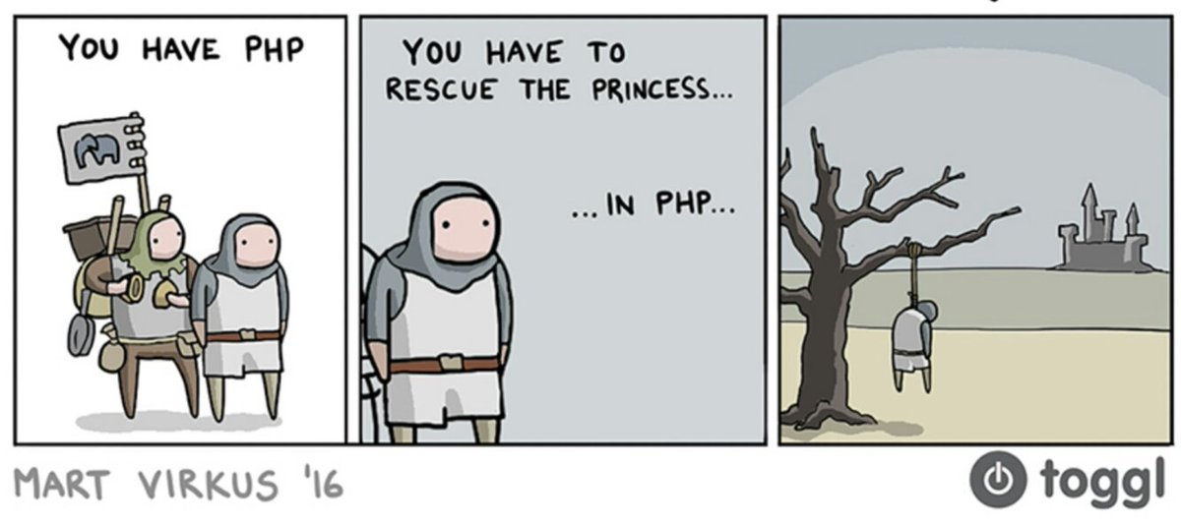
Mart Virkus – (https://blog.toggl.com/author/martvirkus/)
Author : Samuel Jones
Not to be reused without permission
University of Salford Computing Society 2018

Slide 3
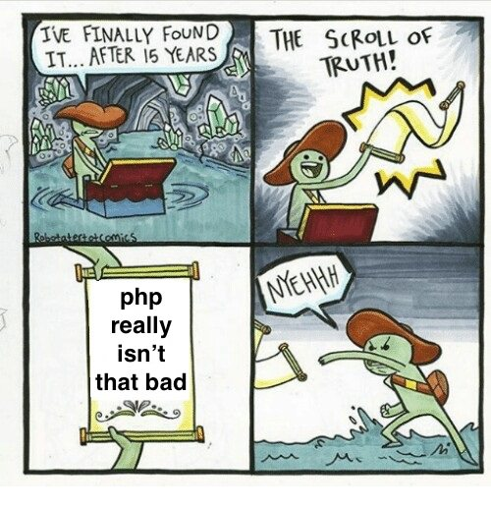
Tate Parker – The specific one was from REDDIT USER (https://www.reddit.com/user/ch3t_manley)
Author : Samuel Jones
Not to be reused without permission
University of Salford Computing Society 2018

Slide 4
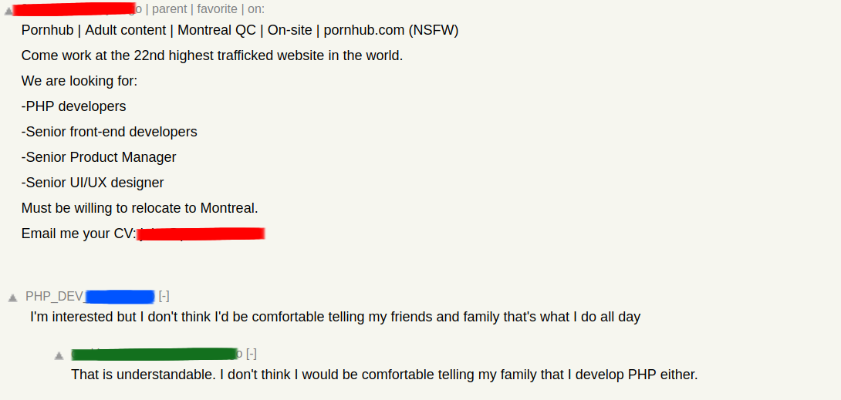
Mark Dawson – (https://www.reddit.com/user/Mark_dawsom)
Author : Samuel Jones
Not to be reused without permission
University of Salford Computing Society 2018

Slide 5
What is PHP5?
The definition given by W3Schools is…
PHP is an acronym for "PHP: Hypertext Preprocessor"
PHP is a widely-used, open source scripting language
PHP scripts are executed on the server
PHP is free to download and use
It is powerful enough to be at the core of the biggest blogging system on the web (WordPress)!
It is deep enough to run the largest social network (Facebook)!
It is also easy enough to be a beginner's first server side language!
Author : Samuel Jones
Not to be reused without permission
University of Salford Computing Society 2018

Slide 6

Lets get started!
Download the template for todays session (:D)…
It can be found on my GITHUB…
https://github.com/SamJones01
We advise you to use PHPStorm
If you need help setting it up give us a shout!
Author : Samuel Jones
Not to be reused without permission
University of Salford Computing Society 2018

Slide 7
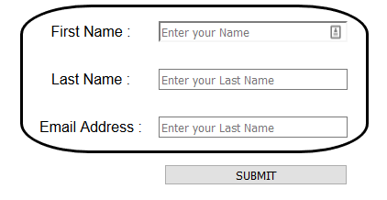
Lets get started!
You should have something like this…
Author : Samuel Jones
Not to be reused without permission
University of Salford Computing Society 2018

Slide 8
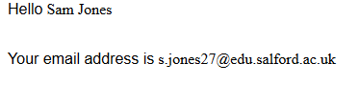
Lets get started!
If you enter values into the fields you will find that they are returned at the bottom of the screen...
Author : Samuel Jones
Not to be reused without permission
University of Salford Computing Society 2018

Slide 9
How does it work?
In PHP variables are declared by using the $ sign
Variables have no one type – they are the type that the data currently being stored in them is
You can use casting operators to assign a variable a type
How Does it Return the values?
The values are returned thanks to the use of $_POST…
$_POST is an array of variables passed to the current script via the HTTP POST method.
It is a global variable…
Global scope refers to any variable that is defined outside of any function.
Author : Samuel Jones
Not to be reused without permission
University of Salford Computing Society 2018

Slide 10
How does it work?
But how does the information get sent I hear you cry.
If you look at the <input> tags you can see another tag named, ironically, name. This is the tag that is used in the array to help identify the input.
Essentially is says…
“Look at what has been entered in the field which name is {BLANK}. Put it in this array”
Author : Samuel Jones
Not to be reused without permission
University of Salford Computing Society 2018

Slide 11
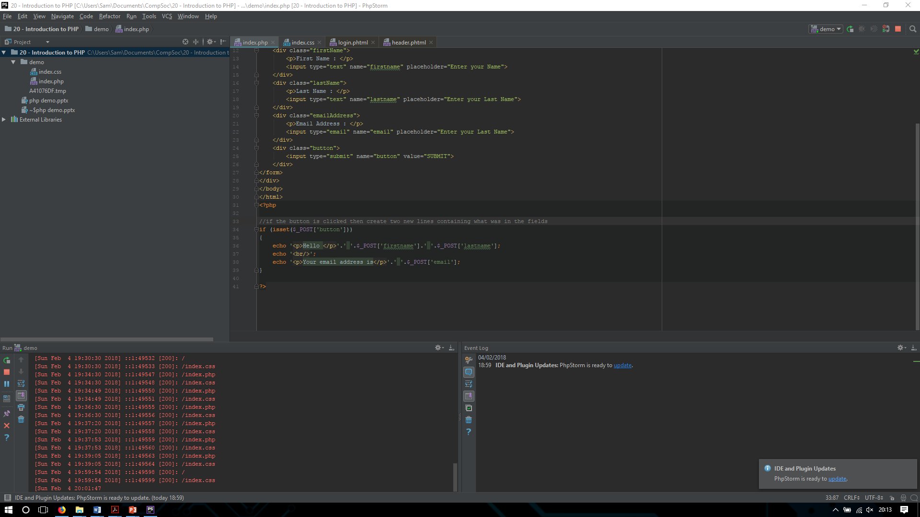
How does it work?
We can then output the value by calling POST…
echo $_POST[‘value of name’];
Author : Samuel Jones
Not to be reused without permission
University of Salford Computing Society 2018

Slide 12
HTML and PHP
You can use the echo function to output html…
Author : Samuel Jones
Not to be reused without permission
University of Salford Computing Society 2018

Slide 13
Now its up to you…
We want you now to do whatever you want with the given template.
You could…
Add more fields
Add html to the output
Add CSS to the output
Do whatever you want
This was a short presentation so please ask any questions you have about the provided material or template
Author : Samuel Jones
Not to be reused without permission
University of Salford Computing Society 2018

Slide 14
References
W3Schools : https://www.w3schools.com/
PHP : https://secure.php.net/
Students Union : https://www.salfordstudents.com/groups/computing
Twitter : https://twitter.com/uoscompsoc?lang=en
GitHub : https://github.com/SamJones01
Author : Samuel Jones
Not to be reused without permission
University of Salford Computing Society 2018

